Slide 1
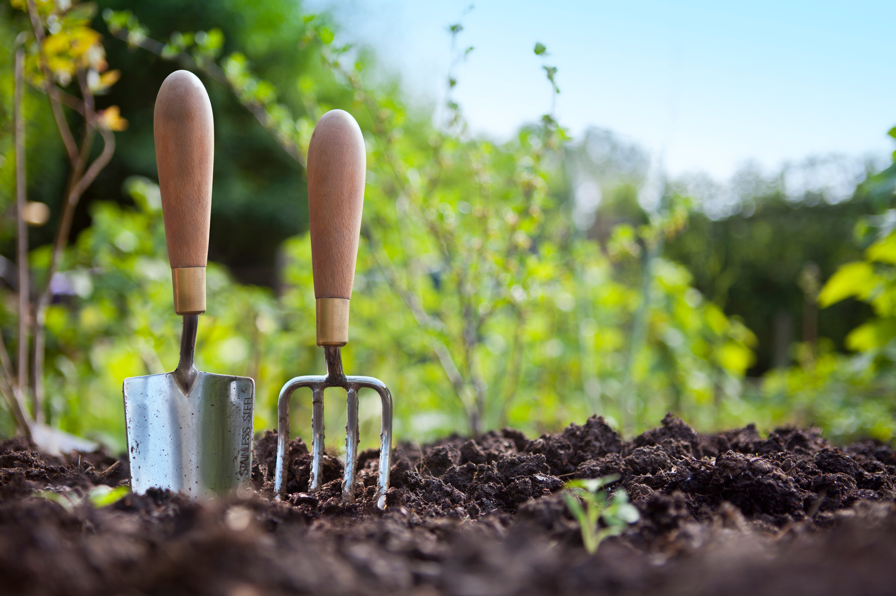
DIG IN COMMUNITY
Developing Integrated Gardens in Community

Slide 2
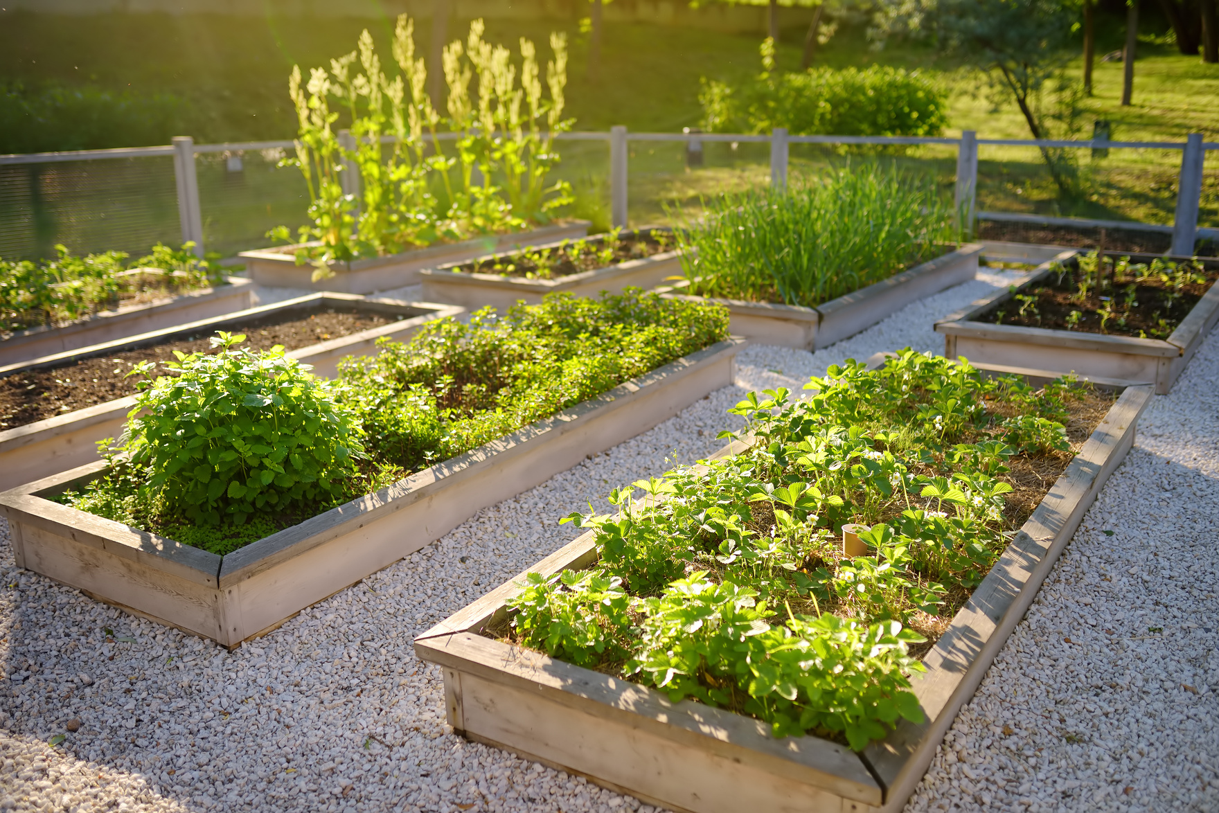
WHAT IS DIG IN COMMUNITY?
  Developing Integrated Gardens in Community.
  Designed to help communities grow and sustain their garden programs.
  Ideas for how to integrate the garden more fully into the community.
  Rate your current garden program, select items to work on, and track growth over time.

Slide 3
“INTEGRATED”:
A well-integrated community garden is a maintained garden in an area accessible to the community; enhances physical, emotional, and spiritual well-being to build a healthy and socially sustainable community; is a valued part of the community's culture and is sustained over time.^{1,2}
1. The Role of Community Gardens in Sustaining Healthy Communities, Designing Healthy Communities, http://designinghealthycommunities.org/role-communitygardens-sustaining-healthy-communities/.
2. Gardner Burt K, Koch PA; Contento IR. (2017) Development of the GREEN (Garden Resources, Education, and Environment Nexus) Tool: An Evidence-Based Model for School Garden Integration. J Acad Nutr Diet, 117:1517-1527.

Slide 4
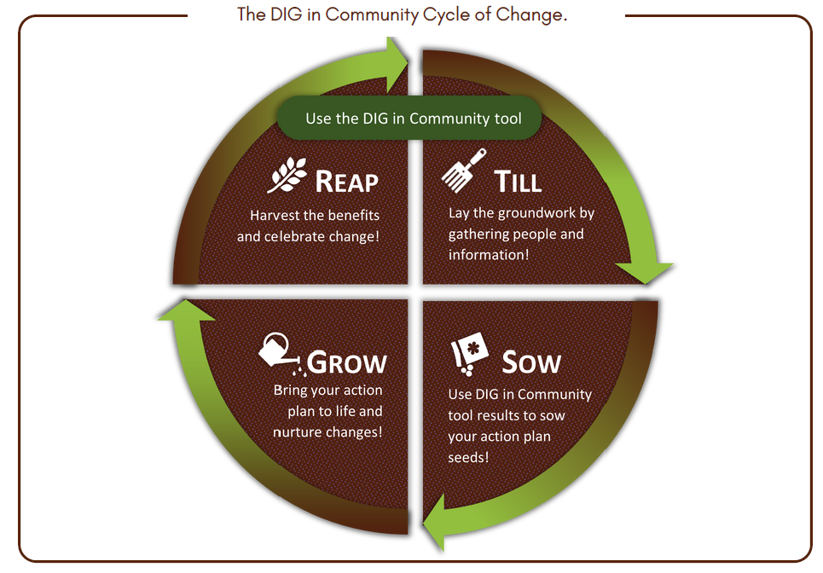

Slide 5
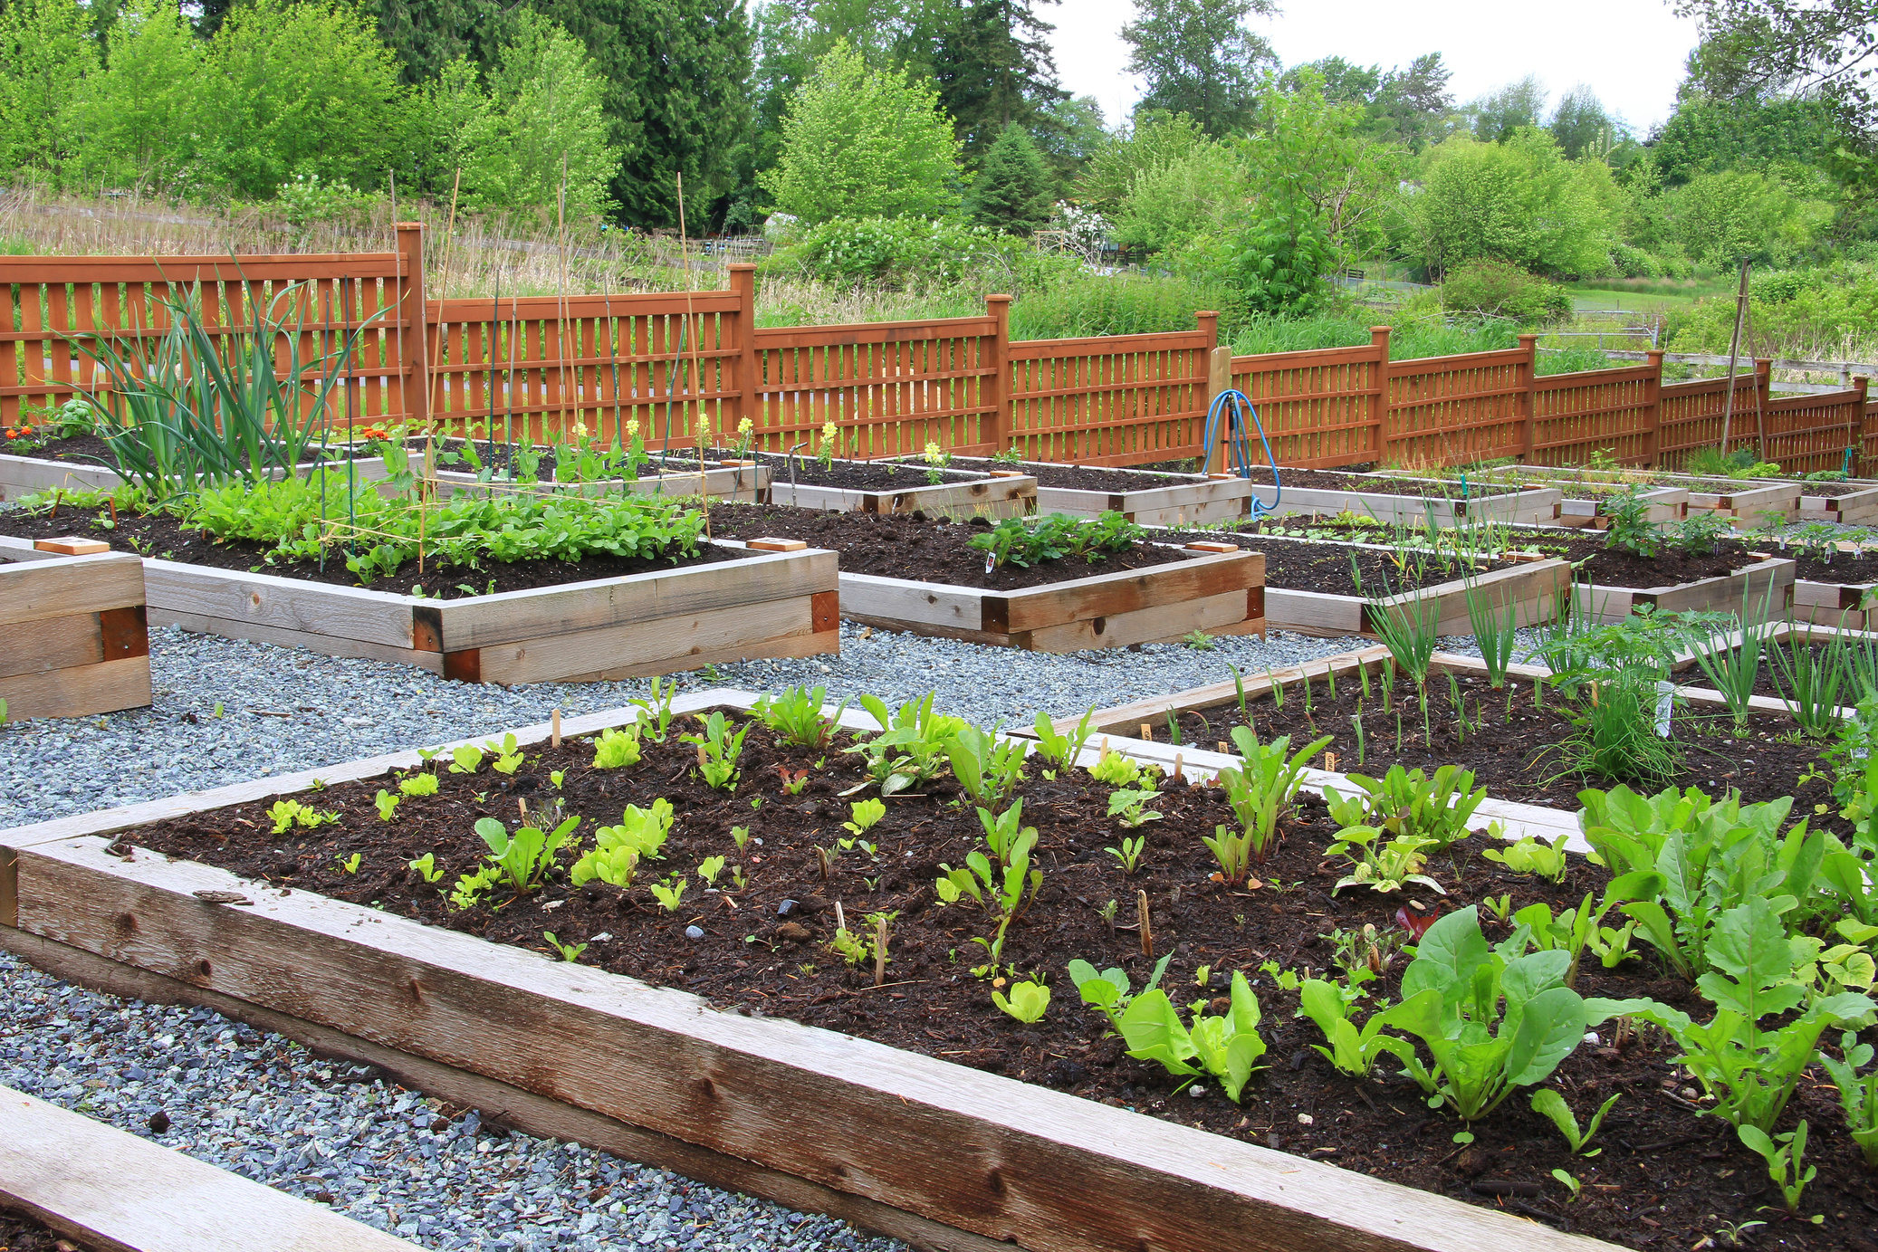
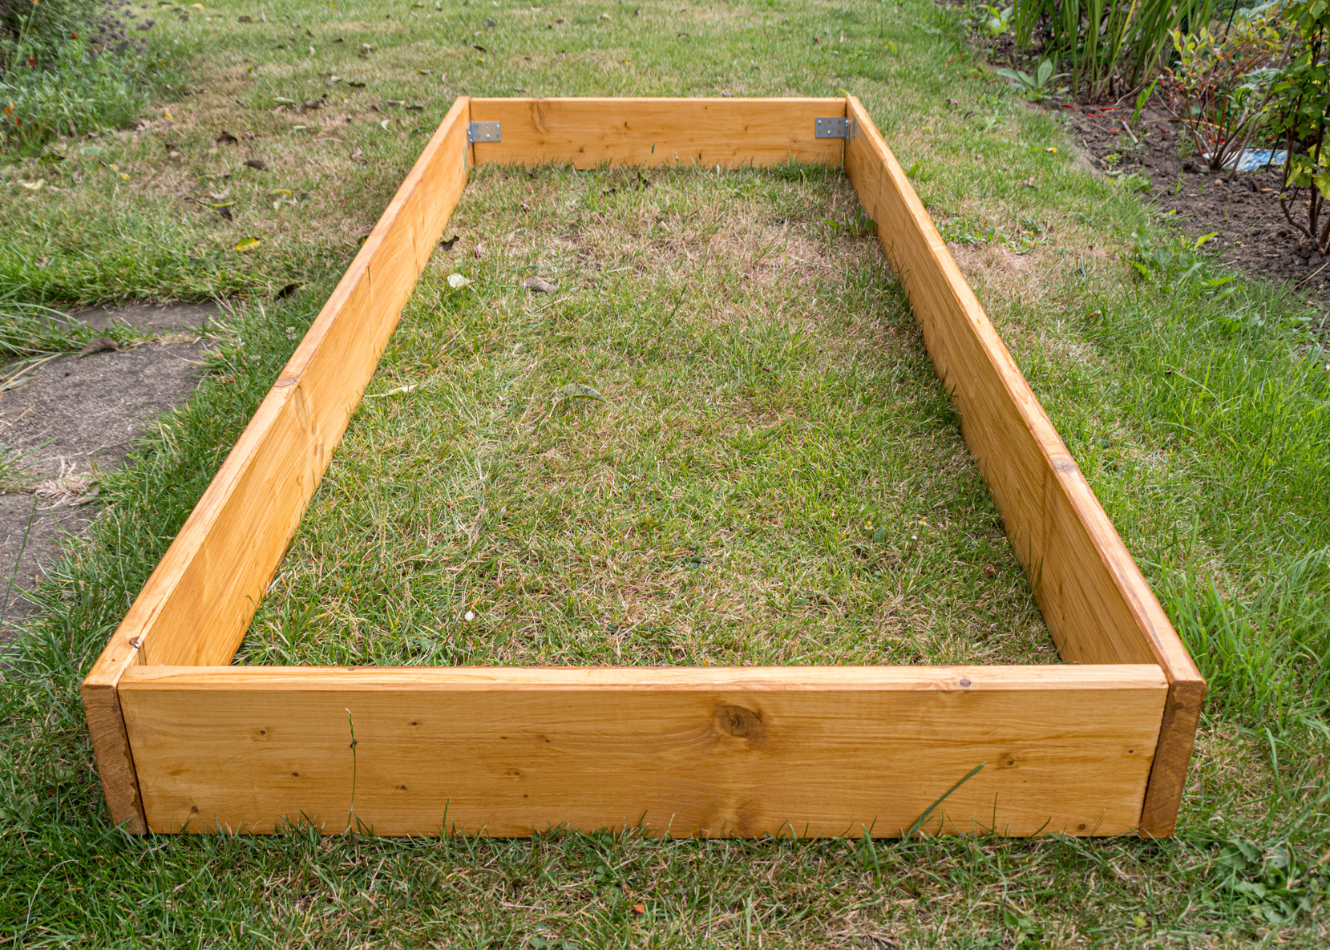
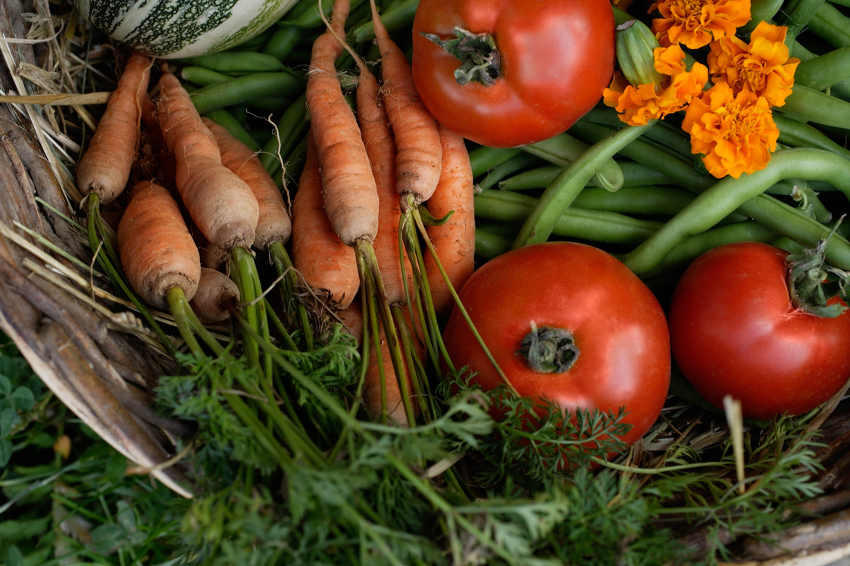
BENEFITS OF DIG IN COMMUNITY
  Collaborate with garden partners.
  Meets you where you are at in garden work!
  Serves as a guide to keep garden flourishing.
  Choose what you want to focus on.
  Track progress and celebrate the fruits of your labor!

Slide 6
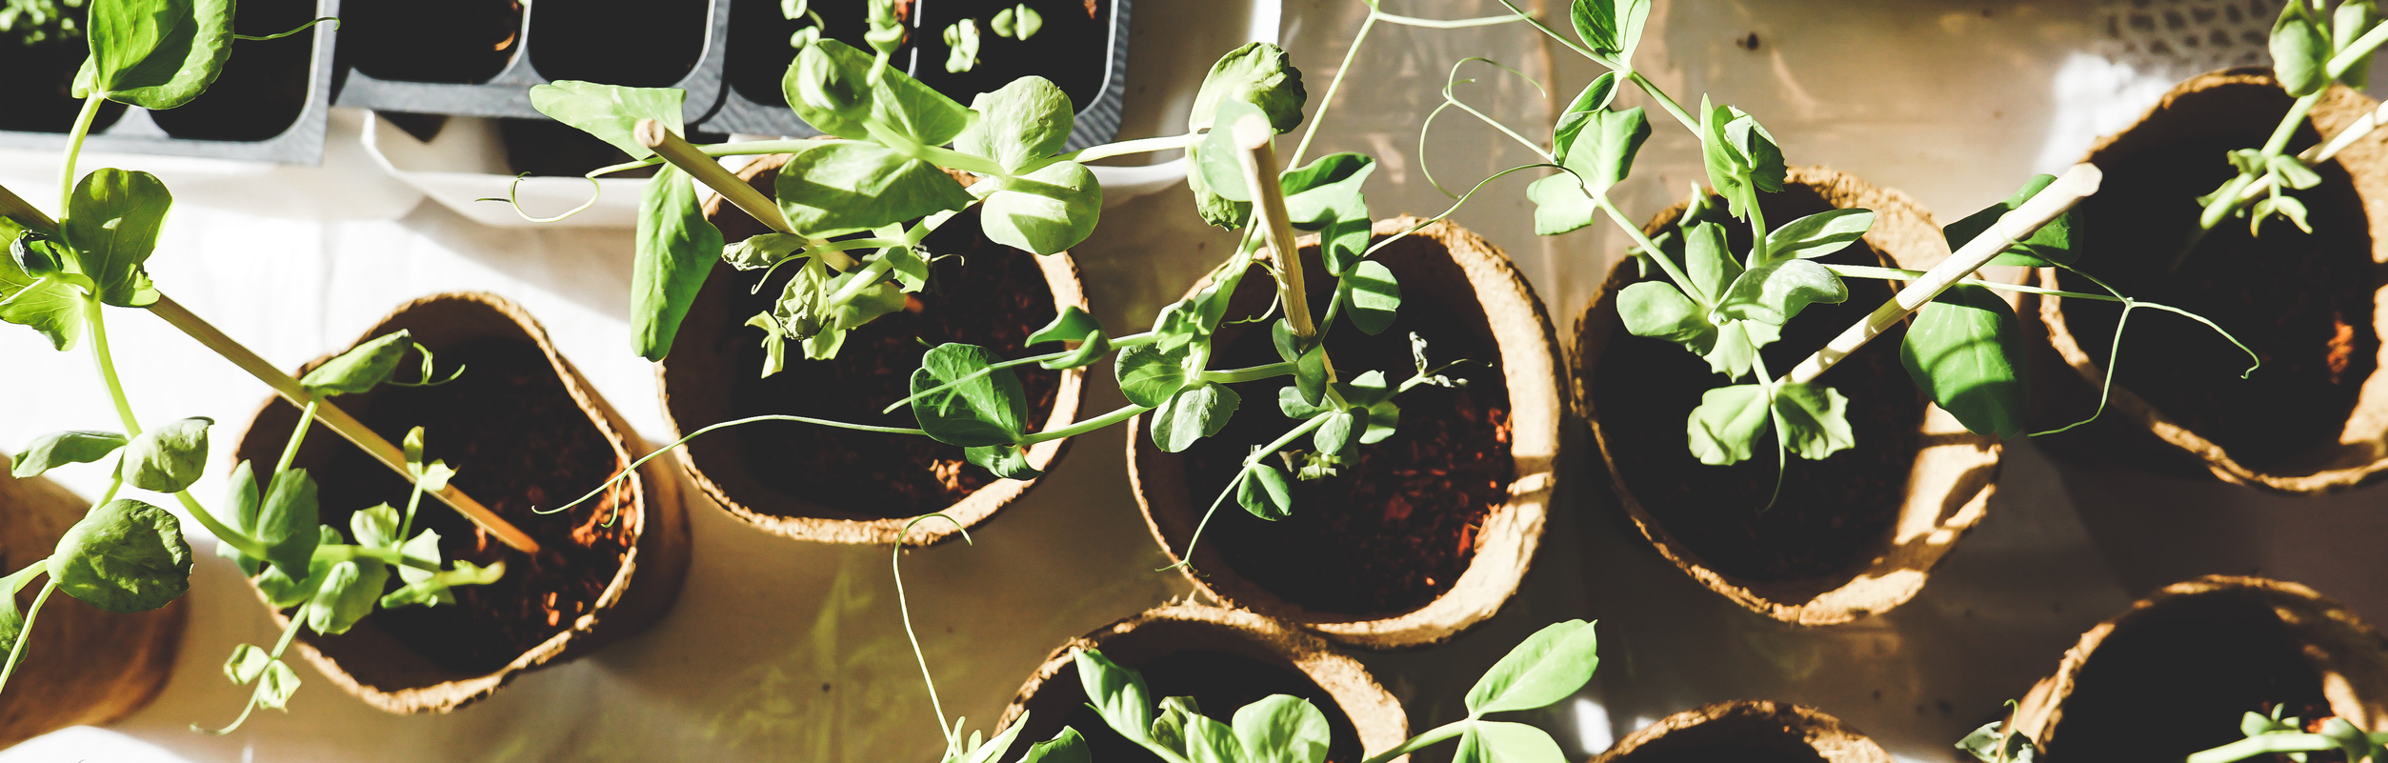
4
8
47
Sections
Subsections
Items
  Some items are low-cost and easy to do, while other ideas can involve more time and resources.
  The tool should give you a sense of how the current garden program functions.
COMPLETING DIG IN COMMUNITY
  Garden sites can choose ideas that work well for their unique setting!
Notes:
.

Slide 7
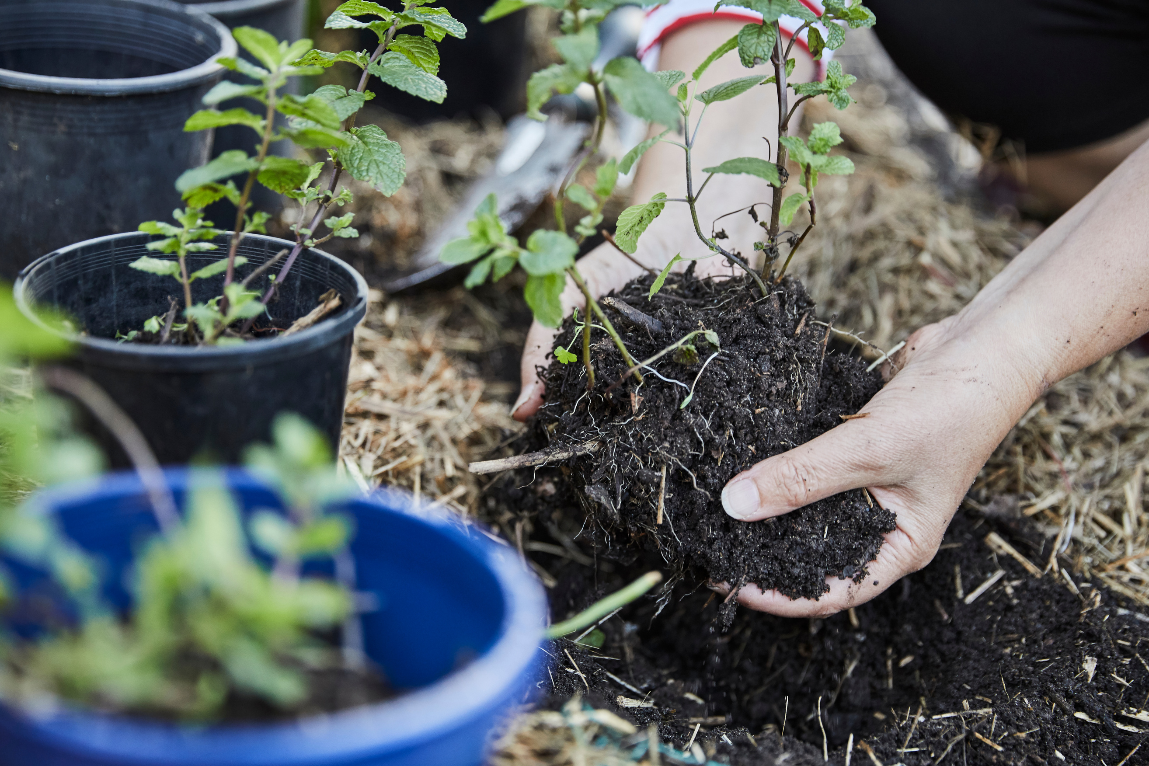
COMPLETING THE
DIG IN COMMUNITY TOOL
INSTRUCTIONS
1
CONNECT WITH YOUR GARDEN PARTNER(S). Schedule a time to connect with the right people.

Slide 8
COMPLETING THE
DIG IN COMMUNITY TOOL
INSTRUCTIONS
1
CONNECT WITH YOUR GARDEN PARTNER(S). Schedule a time to connect with the right people!
2
RATE EACH ITEM BASED ON WHERE THE GARDEN IS AT CURRENTLY.
  Not in Place Right now (0)
  Partly in Place Right Now (1)
  Fully in Place Right now (2)
3
ADD UP YOUR RATINGS. Come to consensus with all individuals completing the tool. Then tally the section and total scores!

Slide 9
COMPLETING THE
DIG IN COMMUNITY TOOL
INSTRUCTIONS
4
REFLECT ON YOUR GOALS. In this unscored section, reflect on what you’d like to achieve in the garden!
5
DISCUSS THE RESULTS WITH YOUR GARDEN COMMUNITY. What are the strengths of the community garden? Where would you most like to grow your program?
Consider what works best and aligns with the needs of the gardening community!

Slide 10
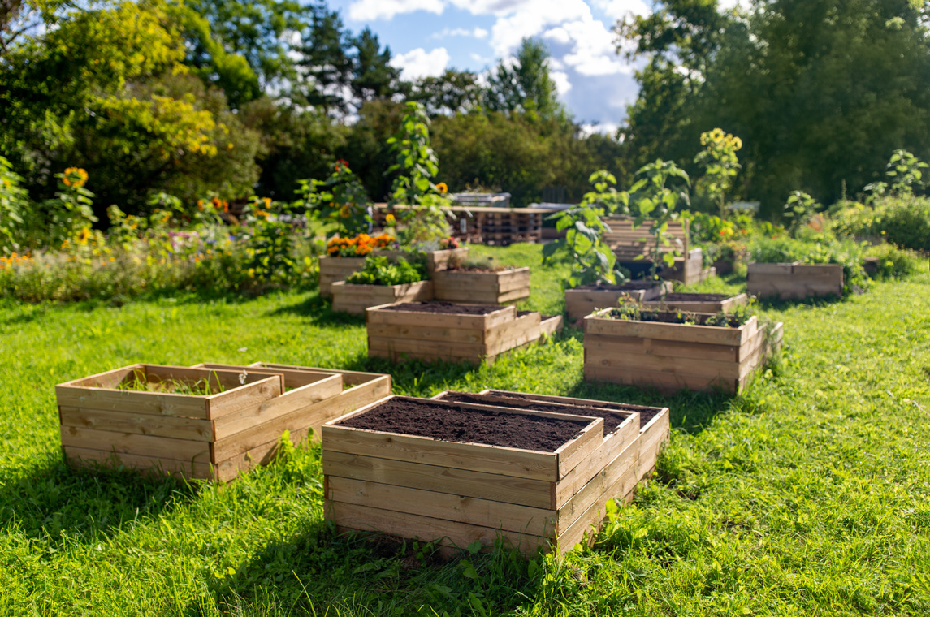


COMPLETING THE
DIG IN COMMUNITY TOOL
BEFORE YOU START:
Our garden program is just getting started.
Our garden program has been around for a while, operating consistently over time.
Our garden program has been around for a while and is now expanding.
Our garden program is currently being revitalized after a dormant period.
Our garden program has been around for a while, but it is currently not very active or is dormant.
If you are just getting started, we suggest focusing on priority items labelled with icons

Slide 11
COMPLETING THE
DIG IN COMMUNITY TOOL
BEFORE YOU START:
Who is completing the DIG in Community tool?
  Garden Champion
  Members of the Garden Committee
  Active Participants of the Garden
The tool should be completed with at least one individual familiar with the garden!

